Slide 1
Image Compression

Slide 2
Introduction and Overview
The field of image compression continues to grow at a rapid pace
The need to store and transmit images will only continue to increase faster than the available capability to process all the data

Slide 3
Applications that require image compression are many and varied such as:
Internet,
Businesses,
Multimedia,
Satellite imaging,
Medical imaging

Slide 4
Compression algorithm development starts with applications to two-dimensional (2-D) still images
After the 2-D methods are developed, they are often extended to video (motion imaging)
However, we will focus on image compression of single frames of image data

Slide 5
Image compression involves reducing the size of image data files, while retaining necessary information
Retaining necessary information depends upon the application
Image segmentation methods, which are primarily a data reduction process, can be used for compression

Slide 6
The reduced file created by the compression process is called the compressed file and is used to reconstruct the image, resulting in the decompressed image
The original image, before any compression is performed, is called the uncompressed image file
The ratio of the original, uncompressed image file and the compressed file is referred to as the compression ratio

Slide 7

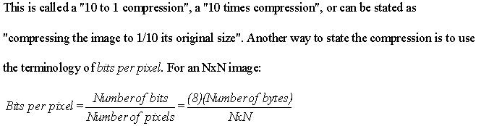
The compression ratio is denoted by:

Slide 8
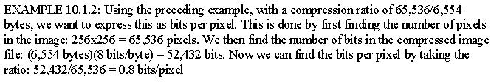
The reduction in file size is necessary to meet the bandwidth requirements for many transmission systems, and for the storage requirements in computer databases
Also, the amount of data required for digital images is enormous

Slide 9
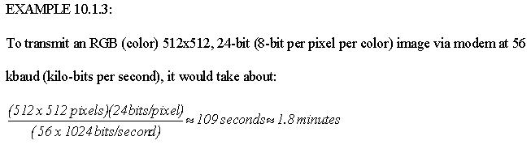
This number is based on the actual transmission rate being the maximum, which is typically not the case due to Internet traffic, overhead bits and transmission errors

Slide 10
Additionally, considering that a web page might contain more than one of these images, the time it takes is simply too long
For high quality images the required resolution can be much higher than the previous example

Slide 11
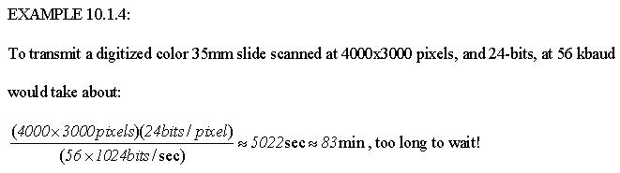
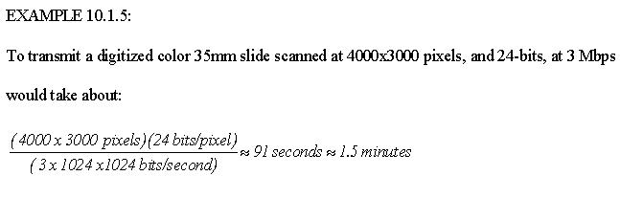
Example 10.1.5 applies maximum data rate to Example 10.1.4

Slide 12
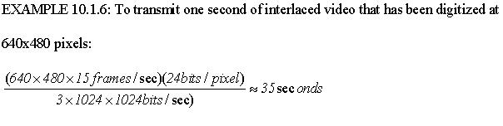
Now, consider the transmission of video images, where we need multiple frames per second
If we consider just one second of video data that has been digitized at 640x480 pixels per frame, and requiring 15 frames per second for interlaced video, then:

Slide 13
Waiting 35 seconds for one second’s worth of video is not exactly real time!
Even attempting to transmit uncompressed video over the highest speed Internet connection is impractical
For example: The Japanese Advanced Earth Observing Satellite (ADEOS) transmits image data at the rate of 120 Mbps

Slide 14
Applications requiring high speed connections such as high definition television, real-time teleconferencing, and transmission of multiband high resolution satellite images, leads us to the conclusion that image compression is not only desirable but necessessary
Key to a successful compression scheme is retaining necessary information

Slide 15
To understand “retaining necessary information”, we must differentiate between data and information
Data:
For digital images, data refers to the pixel gray level values that correspond to the brightness of a pixel at a point in space
Data are used to convey information, much like the way the alphabet is used to convey information via words

Slide 16
Information:
Information is an interpretation of the data in a meaningful way
Information is an elusive concept; it can be application specific

Slide 17
There are two primary types of image compression methods:
Lossless compression methods:
Allows for the exact recreation of the original image data, and can compress complex images to a maximum 1/2 to 1/3 the original size – 2:1 to 3:1 compression ratios
Preserves the data exactly

Slide 18
Lossy compression methods:
Data loss, original image cannot be re-created exactly
Can compress complex images 10:1 to 50:1 and retain high quality, and 100 to 200 times for lower quality, but acceptable, images

Slide 19
Compression algorithms are developed by taking advantage of the redundancy that is inherent in image data
Four primary types of redundancy that can be found in images are:
Coding
Interpixel
Interband
Psychovisual redundancy

Slide 20
Coding redundancy
Occurs when the data used to represent the image is not utilized in an optimal manner
Interpixel redundancy
Occurs because adjacent pixels tend to be highly correlated, in most images the brightness levels do not change rapidly, but change gradually

Slide 21
Interband redundancy
Occurs in color images due to the correlation between bands within an image – if we extract the red, green and blue bands they look similar
Psychovisual redundancy
Some information is more important to the human visual system than other types of information

Slide 22
The key in image compression algorithm development is to determine the minimal data required to retain the necessary information
The compression is achieved by taking advantage of the redundancy that exists in images
If the redundancies are removed prior to compression, for example with a decorrelation process, a more effective compression can be achieved

Slide 23
To help determine which information can be removed and which information is important, the image fidelity criteria are used
These measures provide metrics for determining image quality
It should be noted that the information required is application specific, and that, with lossless schemes, there is no need for a fidelity criteria

Slide 24
Most of the compressed images shown in this chapter are generated with CVIPtools, which consists of code that has been developed for educational and research purposes
The compressed images shown are not necessarily representative of the best commercial applications that use the techniques described, because the commercial compression algorithms are often combinations of the techniques described herein

Slide 25
Compression System Model
The compression system model consists of two parts:
The compressor
The decompressor
The compressor consists of a preprocessing stage and encoding stage, whereas the decompressor consists of a decoding stage followed by a postprocessing stage

Slide 26
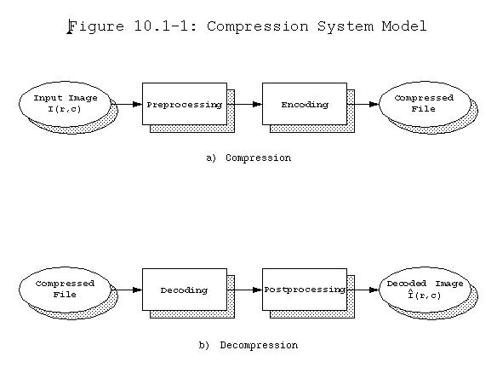
Decompressed image

Slide 27
Before encoding, preprocessing is performed to prepare the image for the encoding process, and consists of any number of operations that are application specific
After the compressed file has been decoded, postprocessing can be performed to eliminate some of the potentially undesirable artifacts brought about by the compression process

Slide 28
The compressor can be broken into following stages:
Data reduction: Image data can be reduced by gray level and/or spatial quantization, or can undergo any desired image improvement (for example, noise removal) process
Mapping: Involves mapping the original image data into another mathematical space where it is easier to compress the data

Slide 29
Quantization: Involves taking potentially continuous data from the mapping stage and putting it in discrete form
Coding: Involves mapping the discrete data from the quantizer onto a code in an optimal manner
A compression algorithm may consist of all the stages, or it may consist of only one or two of the stages

Slide 30
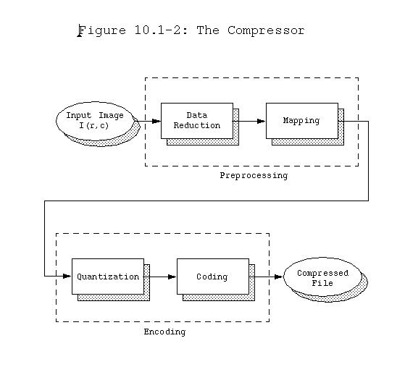

Slide 31
The decompressor can be broken down into following stages:
Decoding: Takes the compressed file and reverses the original coding by mapping the codes to the original, quantized values
Inverse mapping: Involves reversing the original mapping process

Slide 32
Postprocessing: Involves enhancing the look of the final image
This may be done to reverse any preprocessing, for example, enlarging an image that was shrunk in the data reduction process
In other cases the postprocessing may be used to simply enhance the image to ameliorate any artifacts from the compression process itself

Slide 33
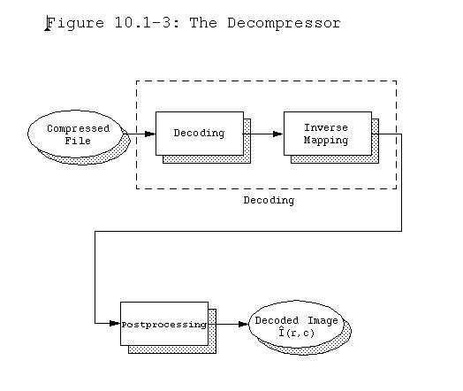
Decompressed image

Slide 34
The development of a compression algorithm is highly application specific
Preprocessing stage of compression consists of processes such as enhancement, noise removal, or quantization are applied
The goal of preprocessing is to prepare the image for the encoding process by eliminating any irrelevant information, where irrelevant is defined by the application

Slide 35
For example, many images that are for viewing purposes only can be preprocessed by eliminating the lower bit planes, without losing any useful information

Slide 36
Lossless compression methods can provide substantial compression for simple images
However, lossless compression techniques may be used for both preprocessing and postprocessing in image compression algorithms to obtain the extra 10% compression

Slide 37
The underlying theory for lossless compression (also called data compaction) comes from the area of communications and information theory, with a mathematical basis in probability theory
One of the most important concepts used is the idea of information content and randomness in data

Slide 38
Huffman Coding
The Huffman code, developed by D. Huffman in 1952, is a minimum length code
This means that given the statistical distribution of the gray levels (the histogram), the Huffman algorithm will generate a code that is as close as possible to the minimum bound, the entropy

Slide 39
The method results in an unequal (or variable) length code, where the size of the code words can vary
For complex images, Huffman coding alone will typically reduce the file by 10% to 50% (1.1:1 to 1.5:1), but this ratio can be improved to 2:1 or 3:1 by preprocessing for irrelevant information removal

Slide 40
The Huffman algorithm can be described in five steps:
Find the gray level probabilities for the image by finding the histogram
Order the input probabilities (histogram magnitudes) from smallest to largest
Combine the smallest two by addition
GOTO step 2, until only two probabilities are left
By working backward along the tree, generate code by alternating assignment of 0 and 1

Slide 41
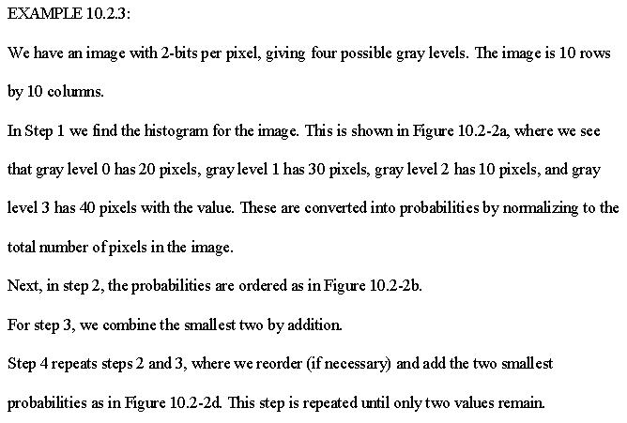

Slide 42
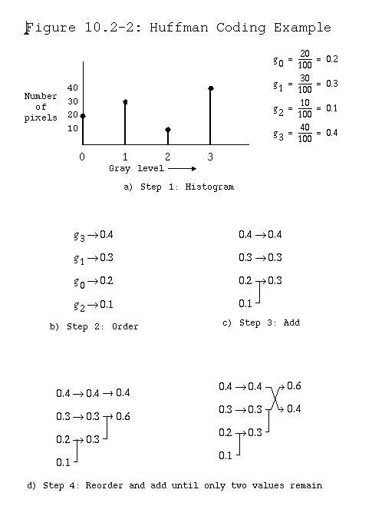

Slide 43
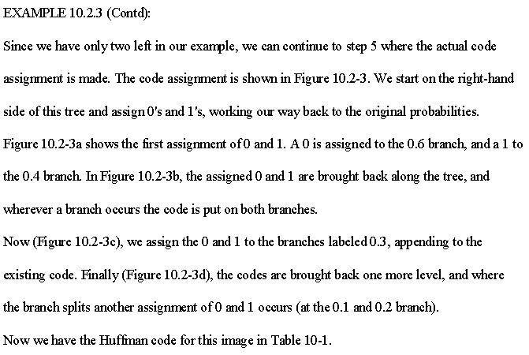

Slide 44
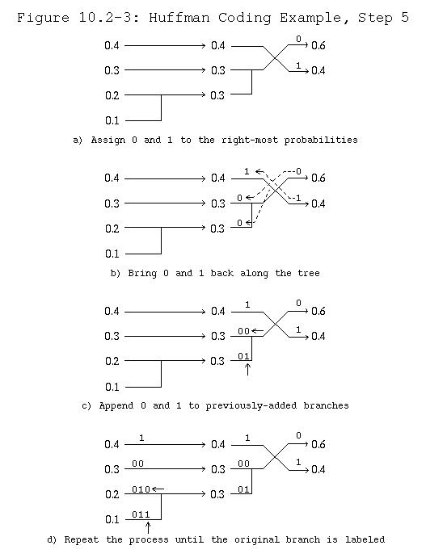

Slide 45
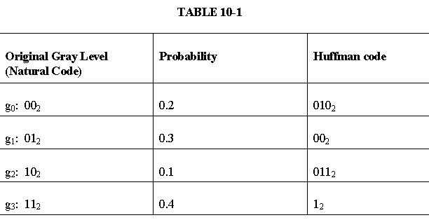

Slide 46
Run-Length Coding
Run-length coding (RLC) works by counting adjacent pixels with the same gray level value called the run-length, which is then encoded and stored
RLC works best for binary, two-valued, images

Slide 47
RLC can also work with complex images that have been preprocessed by thresholding to reduce the number of gray levels to two
RLC can be implemented in various ways, but the first step is to define the required parameters
Horizontal RLC (counting along the rows) or vertical RLC (counting along the columns) can be used

Slide 48
In basic horizontal RLC, the number of bits used for the encoding depends on the number of pixels in a row
If the row has 2^{n} pixels, then the required number of bits is n, so that a run that is the length of the entire row can be encoded

Slide 49
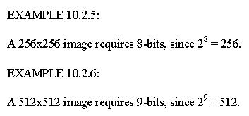
The next step is to define a convention for the first RLC number in a row – does it represent a run of 0's or 1's?

Slide 50
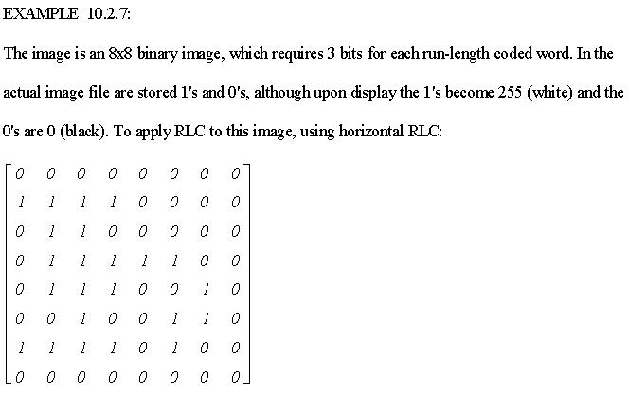

Slide 51
Bitplane-RLC : A technique which involves extension of basic RLC method to gray level images, by applying basic RLC to each bit-plane independently
For each binary digit in the gray level value, an image plane is created, and this image plane (a string of 0's and 1's) is then encoded using RLC

Slide 52
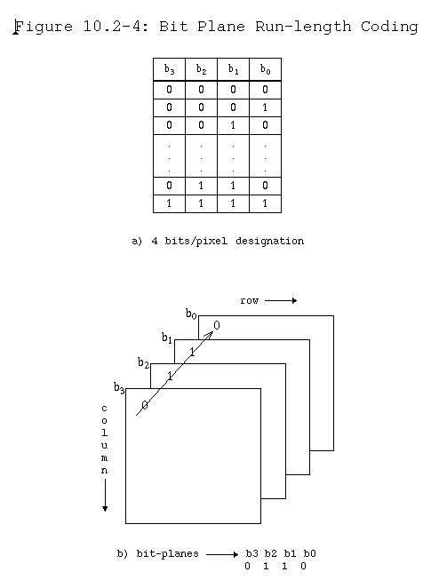

Slide 53
Lempel-Ziv-Welch Coding
The Lempel-Ziv-Welch (LZW) coding algorithm works by encoding strings of data, which correspond to sequences of pixel values in images
It works by creating a string table that contains the strings and their corresponding codes

Slide 54
The string table is updated as the file is read, with new codes being inserted whenever a new string is encountered
If a string is encountered that is already in the table, the corresponding code for that string is put into the compressed file
LZW coding uses code words with more bits than the original data

Slide 55
For Example:
With 8-bit image data, an LZW coding method could employ 10-bit words
The corresponding string table would then have 2¹⁰ = 1024 entries
This table consists of the original 256 entries, corresponding to the original 8-bit data, and allows 768 other entries for string codes

Slide 56
The string codes are assigned during the compression process, but the actual string table is not stored with the compressed data
During decompression the information in the string table is extracted from the compressed data itself

Slide 57
For the GIF (and TIFF) image file format the LZW algorithm is specified, but there has been some controversy over this, since the algorithm is patented by Unisys Corporation
Since these image formats are widely used, other methods similar in nature to the LZW algorithm have been developed to be used with these, or similar, image file formats

Slide 58
Similar versions of this algorithm include the adaptive Lempel-Ziv, used in the UNIX compress function, and the Lempel-Ziv 77 algorithm used in the UNIX gzip function

Slide 59
Arithmetic Coding
Arithmetic coding transforms input data into a single floating point number between 0 and 1
There is not a direct correspondence between the code and the individual pixel values

Slide 60
As each input symbol (pixel value) is read the precision required for the number becomes greater
As the images are very large and the precision of digital computers is finite, the entire image must be divided into small subimages to be encoded

Slide 61
Arithmetic coding uses the probability distribution of the data (histogram), so it can theoretically achieve the maximum compression specified by the entropy
It works by successively subdividing the interval between 0 and 1, based on the placement of the current pixel value in the probability distribution

Slide 62
Lossy Compression Methods
Lossy compression methods are required to achieve high compression ratios with complex images
They provides tradeoffs between image quality and degree of compression, which allows the compression algorithm to be customized to the application

Slide 63
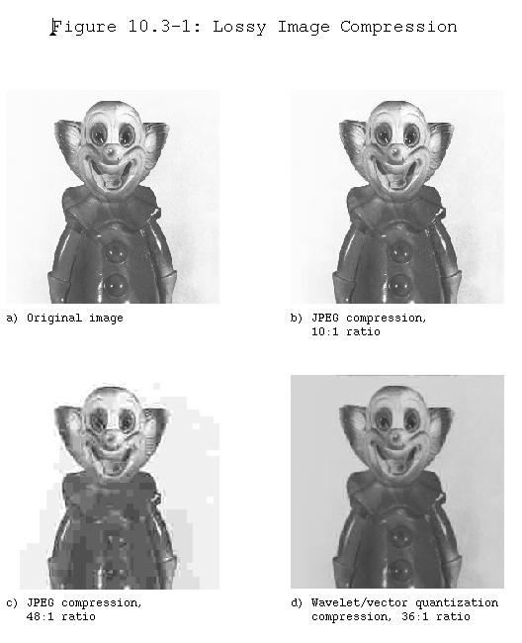

Slide 64
With more advanced methods, images can be compressed 10 to 20 times with virtually no visible information loss, and 30 to 50 times with minimal degradation
Newer techniques, such as JPEG2000, can achieve reasonably good image quality with compression ratios as high as 100 to 200
Image enhancement and restoration techniques can be combined with lossy compression schemes to improve the appearance of the decompressed image

Slide 65
In general, a higher compression ratio results in a poorer image, but the results are highly image dependent – application specific
Lossy compression can be performed in both the spatial and transform domains. Hybrid methods use both domains.

Slide 66
Differential Predictive Coding
Differential predictive coding (DPC) predicts the next pixel value based on previous values, and encodes the difference between predicted and actual value – the error signal
This technique takes advantage of the fact that adjacent pixels are highly correlated, except at object boundaries

Slide 67
Typically the difference, or error, will be small which minimizes the number of bits required for compressed file
This error is then quantized, to further reduce the data and to optimize visual results, and can then be coded

Slide 68
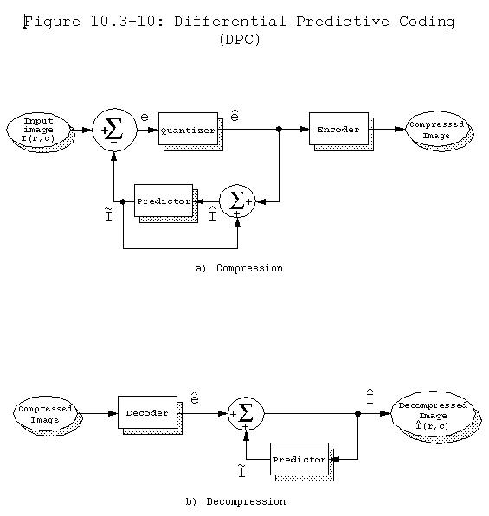

Slide 69
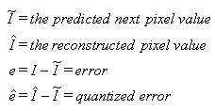
From the block diagram, we have the following:
The prediction equation is typically a function of the previous pixel(s), and can also include global or application-specific information

Slide 70
Transform Coding
Transform coding, is a form of block coding done in the transform domain
The image is divided into blocks, or subimages, and the transform is calculated for each block

Slide 71
Any of the previously defined transforms can be used, frequency (e.g. Fourier) or sequency (e.g. Walsh/Hadamard), but it has been determined that the discrete cosine transform (DCT) is optimal for most images
The newer JPEG2000 algorithms uses the wavelet transform, which has been found to provide even better compression

Slide 72
After the transform has been calculated, the transform coefficients are quantized and coded
This method is effective because the frequency/sequency transform of images is very efficient at putting most of the information into relatively few coefficients, so many of the high frequency coefficients can be quantized to 0 (eliminated completely)

Slide 73
This type of transform is a special type of mapping that uses spatial frequency concepts as a basis for the mapping
The main reason for mapping the original data into another mathematical space is to pack the information (or energy) into as few coefficients as possible

Slide 74
The simplest form of transform coding is achieved by filtering by eliminating some of the high frequency coefficients
However, this will not provide much compression, since the transform data is typically floating point and thus 4 or 8 bytes per pixel (compared to the original pixel data at 1 byte per pixel), so quantization and coding is applied to the reduced data

Slide 75
Quantization includes a process called bit allocation, which determines the number of bits to be used to code each coefficient based on its importance
Typically, more bits are used for lower frequency components where the energy is concentrated for most images, resulting in a variable bit rate or nonuniform quantization and better resolution

Slide 76
Then a quantization scheme, such as Lloyd-Max quantization is applied
As the zero-frequency coefficient for real images contains a large portion of the energy in the image and is always positive, it is typically treated differently than the higher frequency coefficients
Often this term is not quantized at all, or the differential between blocks is encoded
After they have been quantized, the coefficients can be coded using, for example, a Huffman or arithmetic coding method

Slide 77
Two particular types of transform coding have been widely explored:
Zonal coding
Threshold coding
These two vary in the method they use for selecting the transform coefficients to retain (using ideal filters for transform coding selects the coefficients based on their location in the transform domain)

Slide 78
Zonal coding
It involves selecting specific coefficients based on maximal variance
A zonal mask is determined for the entire image by finding the variance for each frequency component
This variance is calculated by using each subimage within the image as a separate sample and then finding the variance within this group of subimages

Slide 79
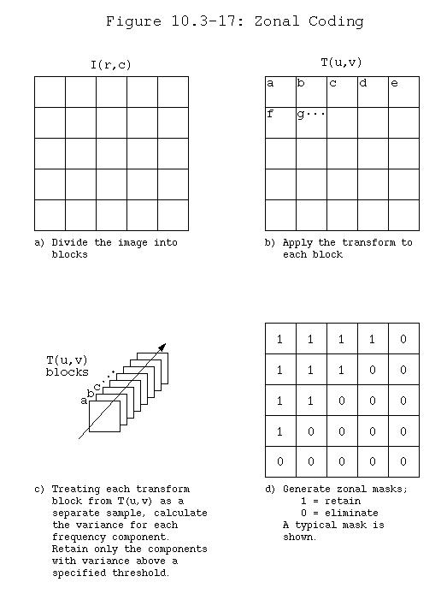

Slide 80
The zonal mask is a bitmap of 1's and 0', where the 1's correspond to the coefficients to retain, and the 0's to the ones to eliminate
As the zonal mask applies to the entire image, only one mask is required

Slide 81
Threshold coding
It selects the transform coefficients based on specific value
A different threshold mask is required for each block, which increases file size as well as algorithmic complexity

Slide 82
In practice, the zonal mask is often predetermined because the low frequency terms tend to contain the most information, and hence exhibit the most variance
In this case we select a fixed mask of a given shape and desired compression ratio, which streamlines the compression process

Slide 83
It also saves the overhead involved in calculating the variance of each group of subimages for compression and also eases the decompression process
Typical masks may be square, triangular or circular and the cutoff frequency is determined by the compression ratio

Slide 84
One of the most commonly used image compression standards is primarily a form of transform coding
The Joint Photographic Expert Group (JPEG) under the auspices of the International Standards Organization (ISO) devised a family of image compression methods for still images
The original JPEG standard uses the DCT and 8x8 pixel blocks as the basis for compression

Slide 85
Before computing the DCT, the pixel values are level shifted so that they are centered at zero
EXAMPLE 10.3.7:
A typical 8-bit image has a range of gray levels of 0 to 255. Level shifting this range to be centered at zero involves subtracting 128 from each pixel value, so the resulting range is from -128 to 127

Slide 86
After level shifting, the DCT is computed
Next, the DCT coefficients are quantized by dividing by the values in a quantization table and then truncated
For color signals JPEG transforms the RGB components into the YCrCb color space, and subsamples the two color difference signals (Cr and Cb), since we perceive more detail in the luminance (brightness) than in the color information

Slide 87
Once the coefficients are quantized, they are coded using a Huffman code
The zero-frequency coefficient (DC term) is differentially encoded relative to the previous block

Slide 88
Hybrid and Wavelet Methods
Hybrid methods use both the spatial and spectral domains
Algorithms exist that combine differential coding and spectral transforms for analog video compression

Slide 89
For digital images these techniques can be applied to blocks (subimages), as well as rows or columns
Vector quantization is often combined with these methods to achieve higher compression ratios
The wavelet transform, which localizes information in both the spatial and frequency domain, is used in newer hybrid compression methods like the JPEG2000 standard

Slide 90
The wavelet transform provides superior performance to the DCT-based techniques, and also is useful in progressive transmission for Internet and database use
Progressive transmission allows low quality images to appear quickly and then gradually improve over time as more detail information is transmitted or retrieved

Slide 91
Thus the user need not wait for an entire high quality image before they decide to view it or move on
The wavelet transform combined with vector quantization has led to the development of experimental compression algorithms

Slide 92
The general algorithm is as follows:
Perform the wavelet transform on the image by using convolution masks
Number the different wavelet bands from 0 to N−1, where N is the total number of wavelet bands, and 0 is the lowest frequency (in both horizontal and vertical directions) band

Slide 93
Scalar quantize the 0 band linearly to 8 bits
Vector quantize the middle bands using a small block size (e.g. 2x2). Decrease the codebook size as the band number increases
Eliminate the highest frequency bands

Slide 94
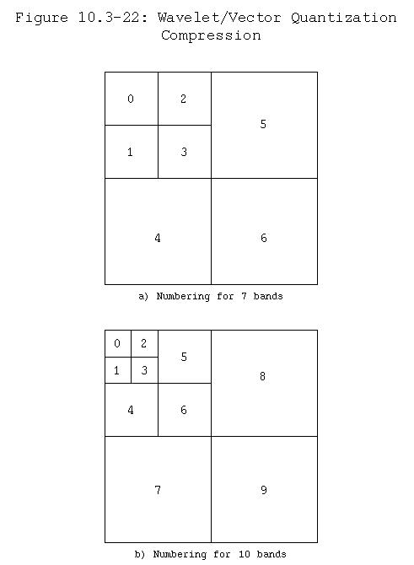

Slide 95
The example algorithms shown here utilize 10‑band wavelet decomposition (Figure 10.3-22b), with the Daubecies 4 element basis vectors, in combination with the vector quantization technique
They are called Wavelet/Vector Quantization followed by a number (WVQ#); specifically WVQ2, WVQ3 and WVQ4

Slide 96
One algorithm (WVQ4) employs the PCT for preprocessing, before subsampling the second and third PCT bands by a factor of 2:1 in the horizontal and vertical direction

Slide 97
The JPEG2000 standard is also based on the wavelet transform
It provides high quality images at very high compression ratios
The committee that developed the standard had certain goals for JPEG2000

Slide 98
The goals are as follows:
To provide better compression than the DCT-based JPEG algorithm
To allow for progressive transmission of high quality images
To be able to compress binary and continuous tone images by allowing 1 to 16 bits for image components

Slide 99
To allow random access to subimages
To be robust to transmission errors
To allow for sequentially image encoding
The JPEG2000 compression method begins by level shifting the data to center it at zero, followed by an optional transform to decorrelate the data, such as a color transform for color images

Slide 100
The one-dimensional wavelet transform is applied to the rows and columns, and the coefficients are quantized based on the image size and number of wavelet bands utilized
These quantized coefficients are then arithmetically coded on a bitplane basis

Slide 101
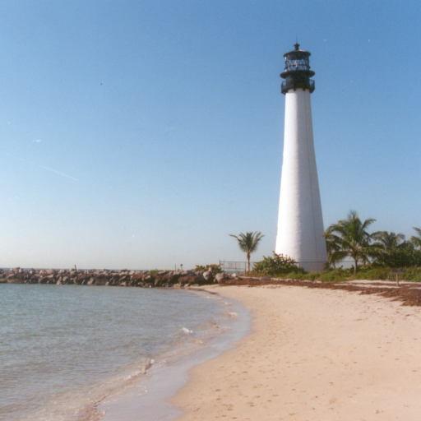
Figure 10.3-24: The JPEG2000 Algorithm Applied to a
Color Image
a) The original image

Slide 102


Figure 10.3-24: The JPEG2000 Algorithm Applied to a
Color Image (contd)
b) Compression ratio = 130 ,
compare to Fig10.3-21e (next slide)
c) Compression ratio = 200,
compare to Fig10.3-21f

Slide 103
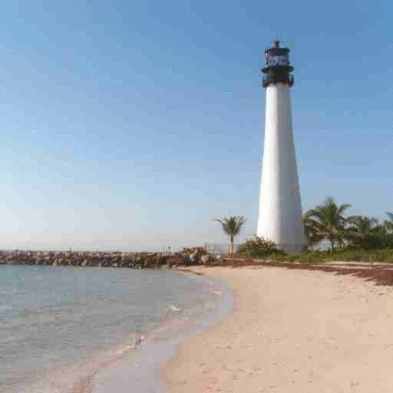
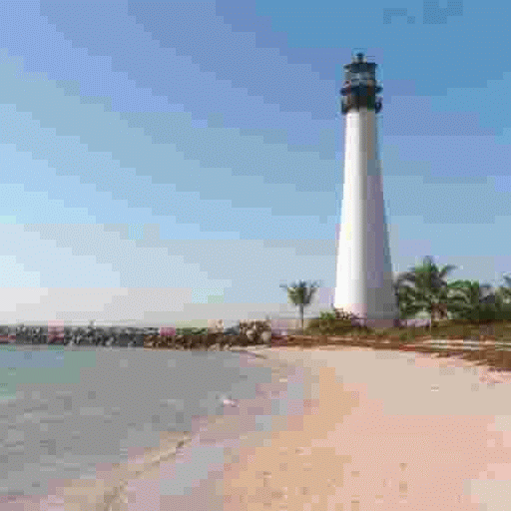
Figure 10.3-21:The Original DCT-based JPEG
Algorithm Applied to a Color Image (contd)
e) Compression ratio = 131.03
f) Compression ratio = 201.39

Slide 104
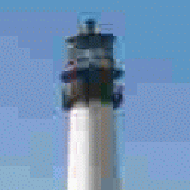
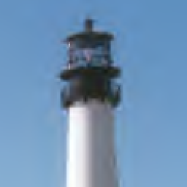
Figure 10.3-24: The JPEG2000 Algorithm Applied to a
Color Image (contd)
d) A 128x128 subimage cropped from
the standard JPEG image and enlarged
to 256x256 using zero-order hold
e) A 128x128 subimage cropped from
the JPEG2000 image and enlarged to
256x256 using zero order hold
Note: The JPEG2000 image is much smoother, even with the zero-order hold enlargement

